Slide 1
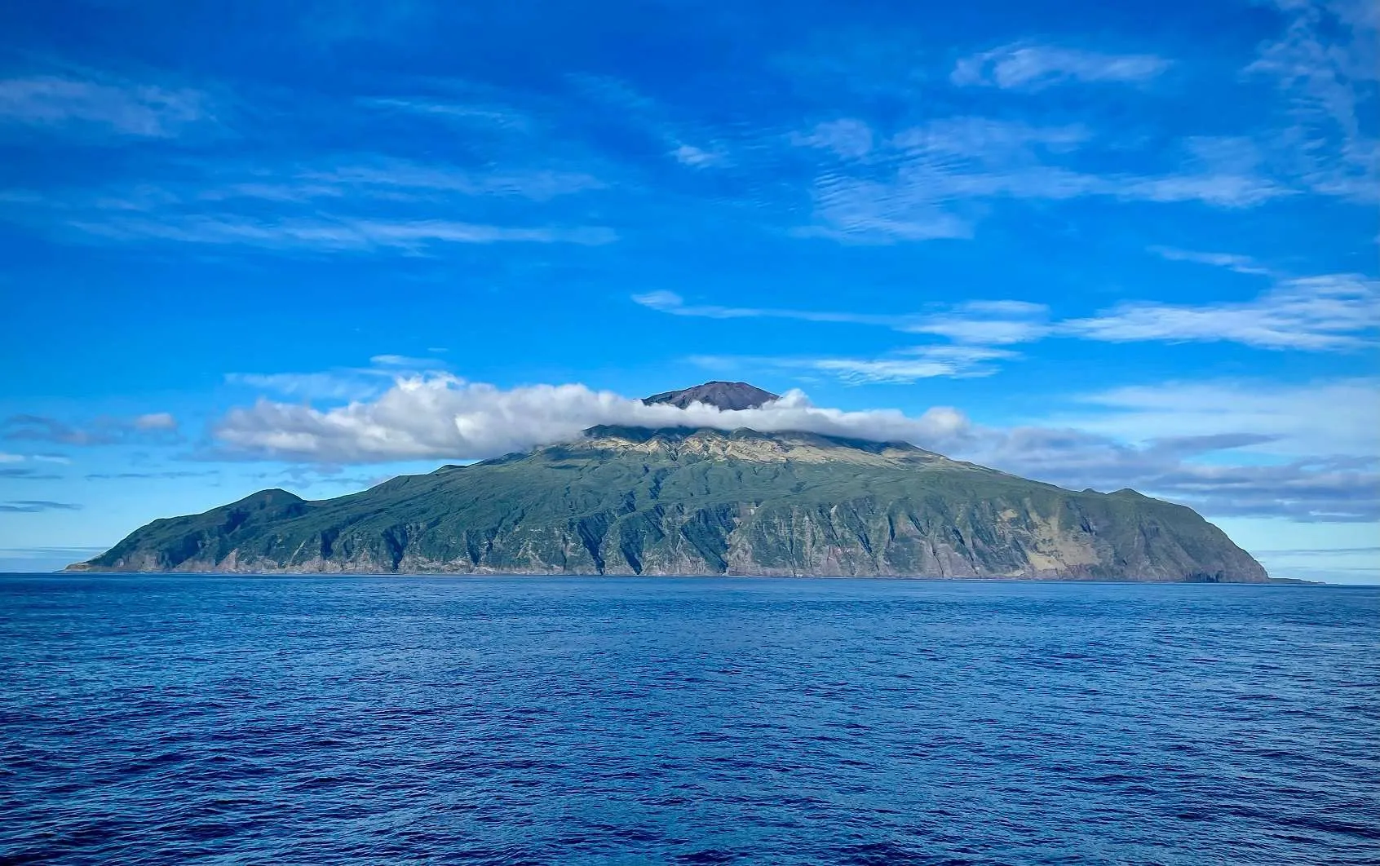
eBird Seamounts

Slide 2


Slide 3
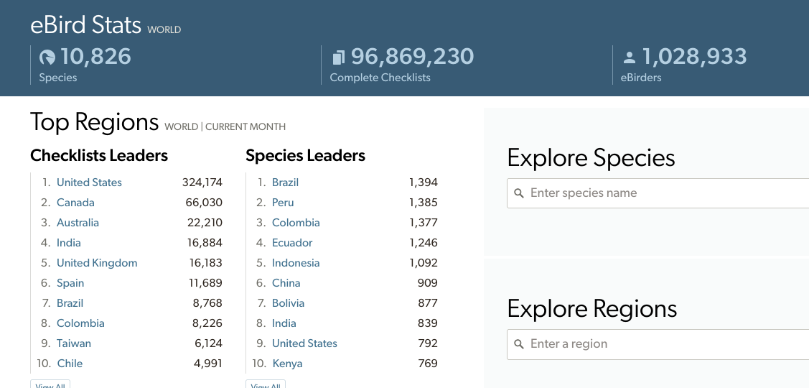

Slide 4
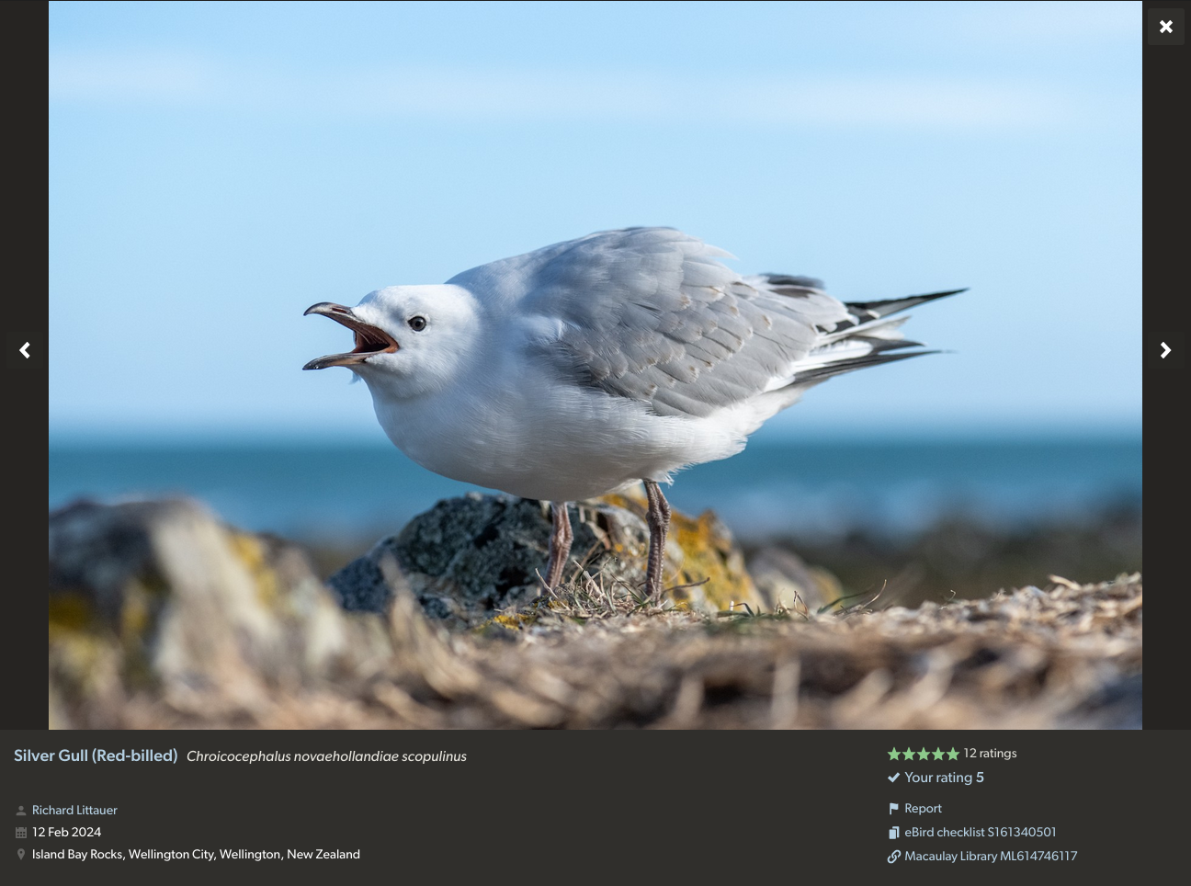

Slide 5
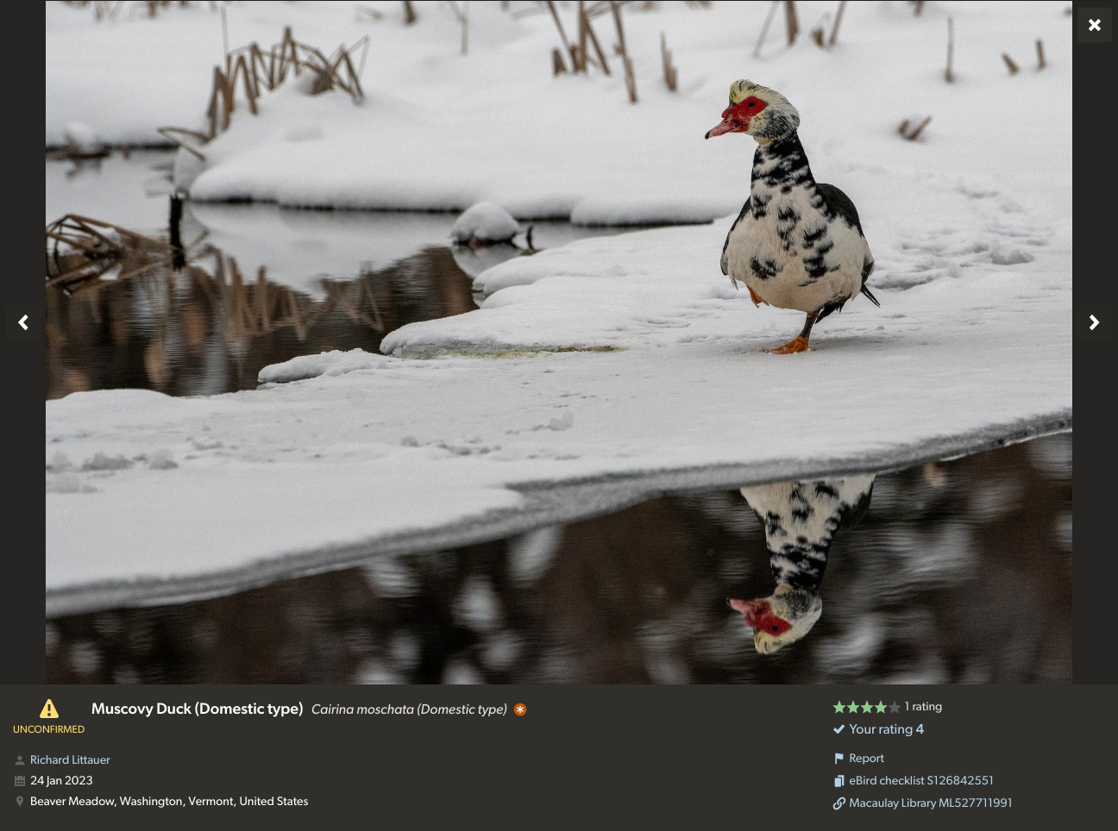

Slide 6
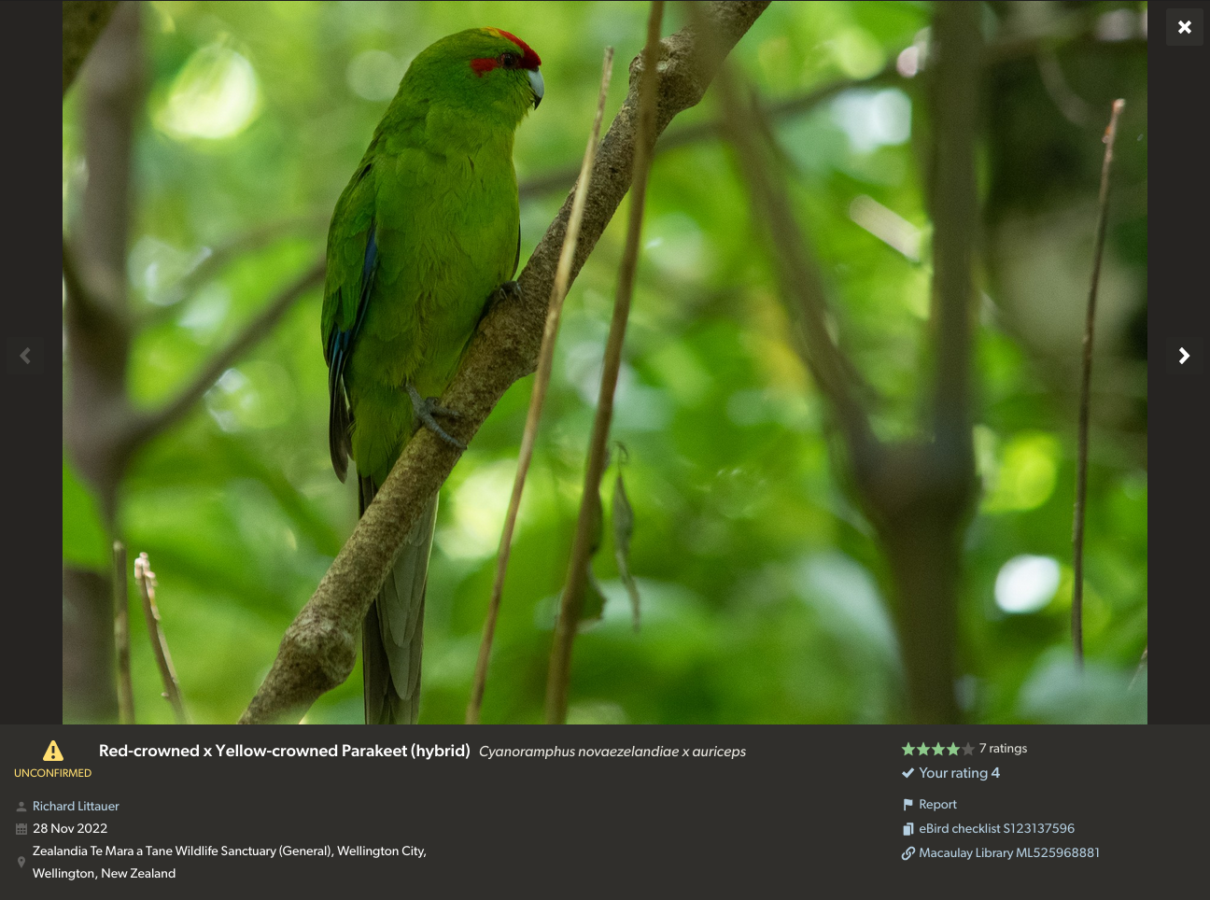

Slide 7
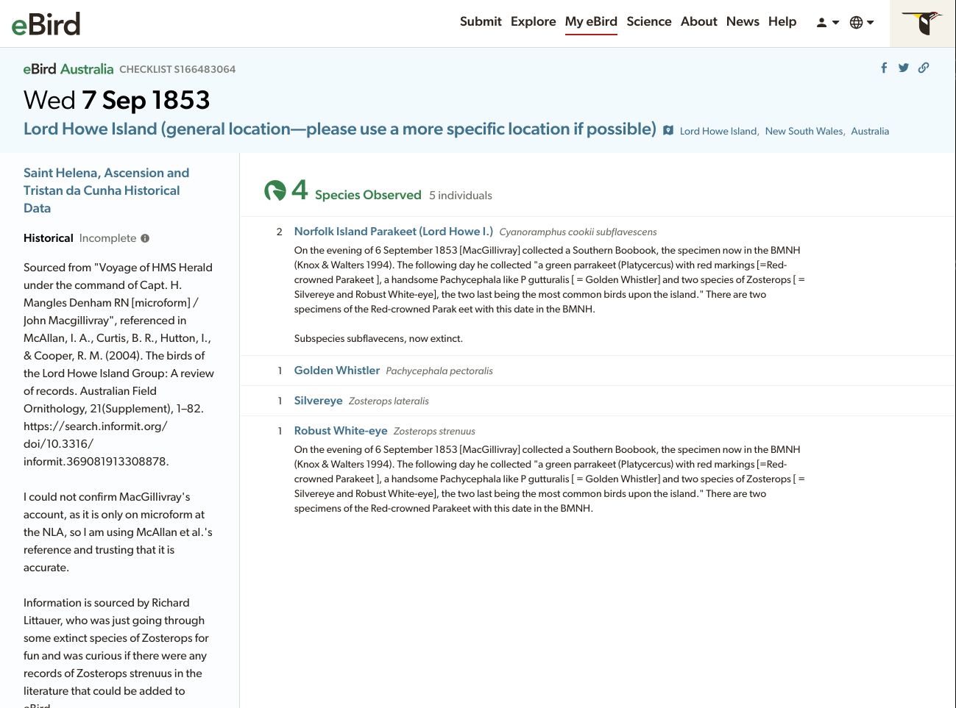

Slide 8
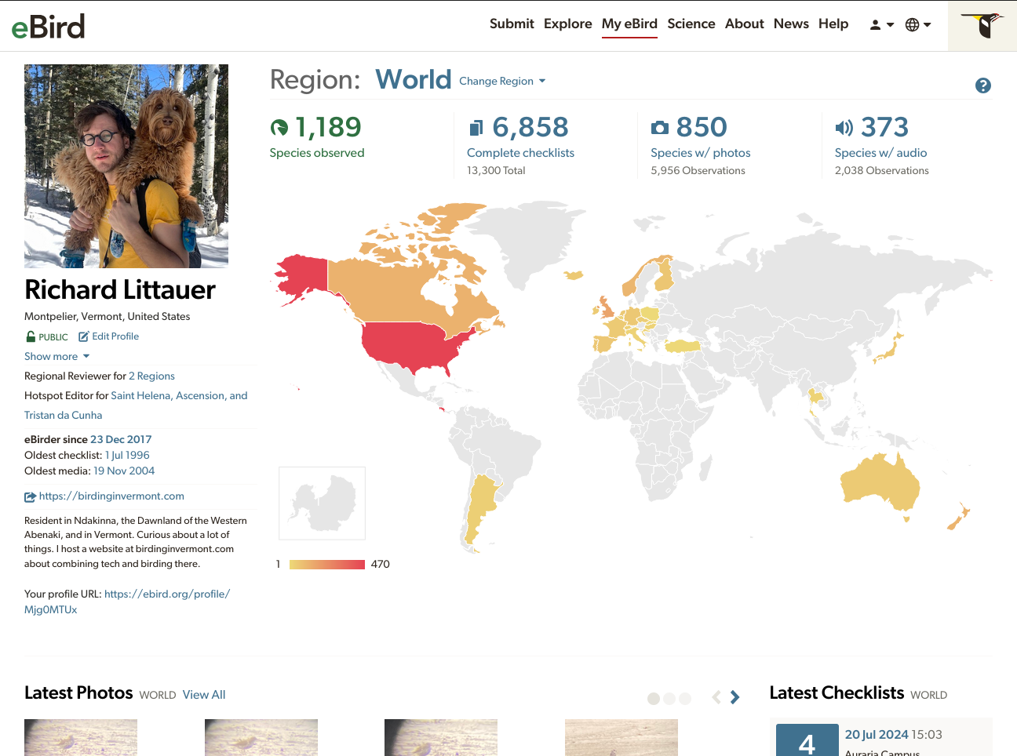

Slide 9
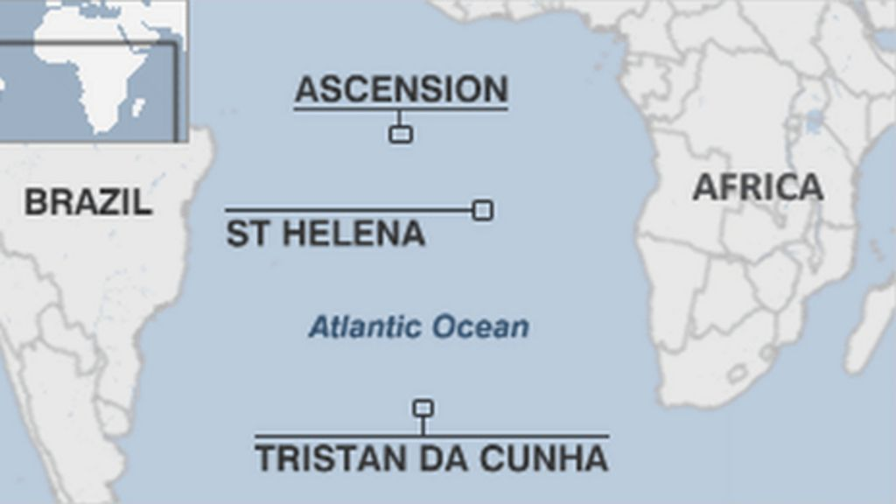

Slide 10
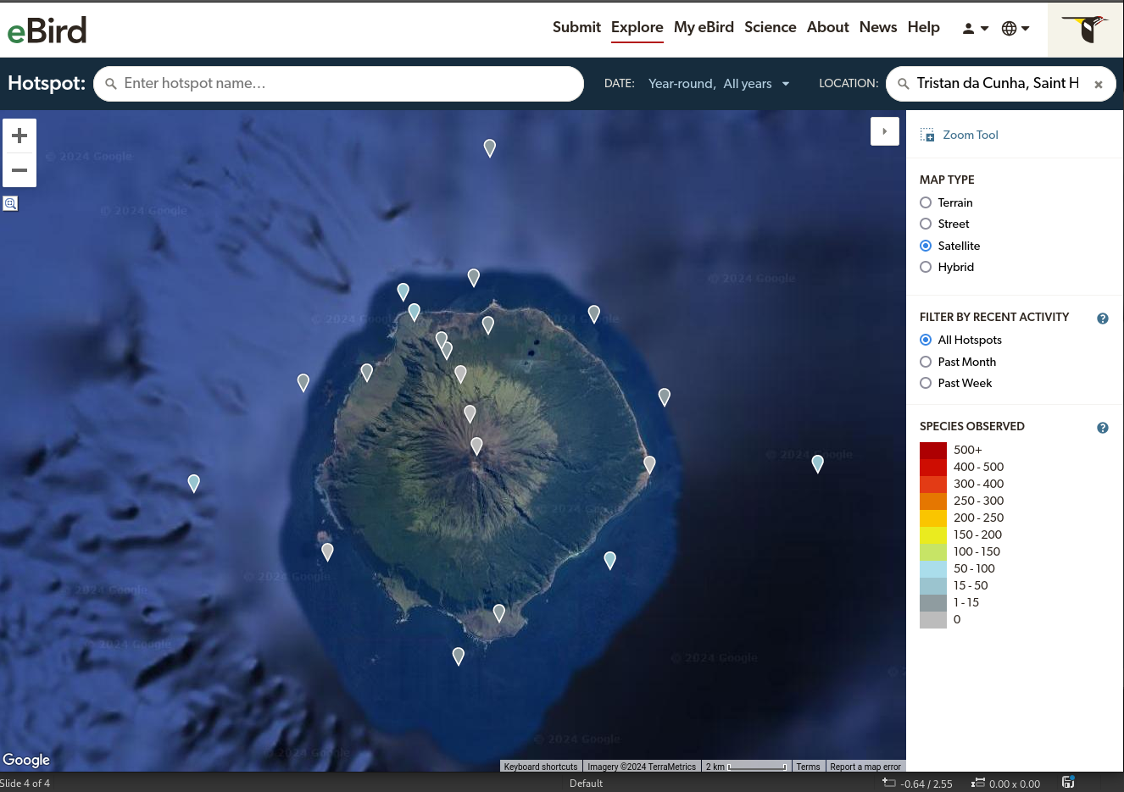

Slide 11
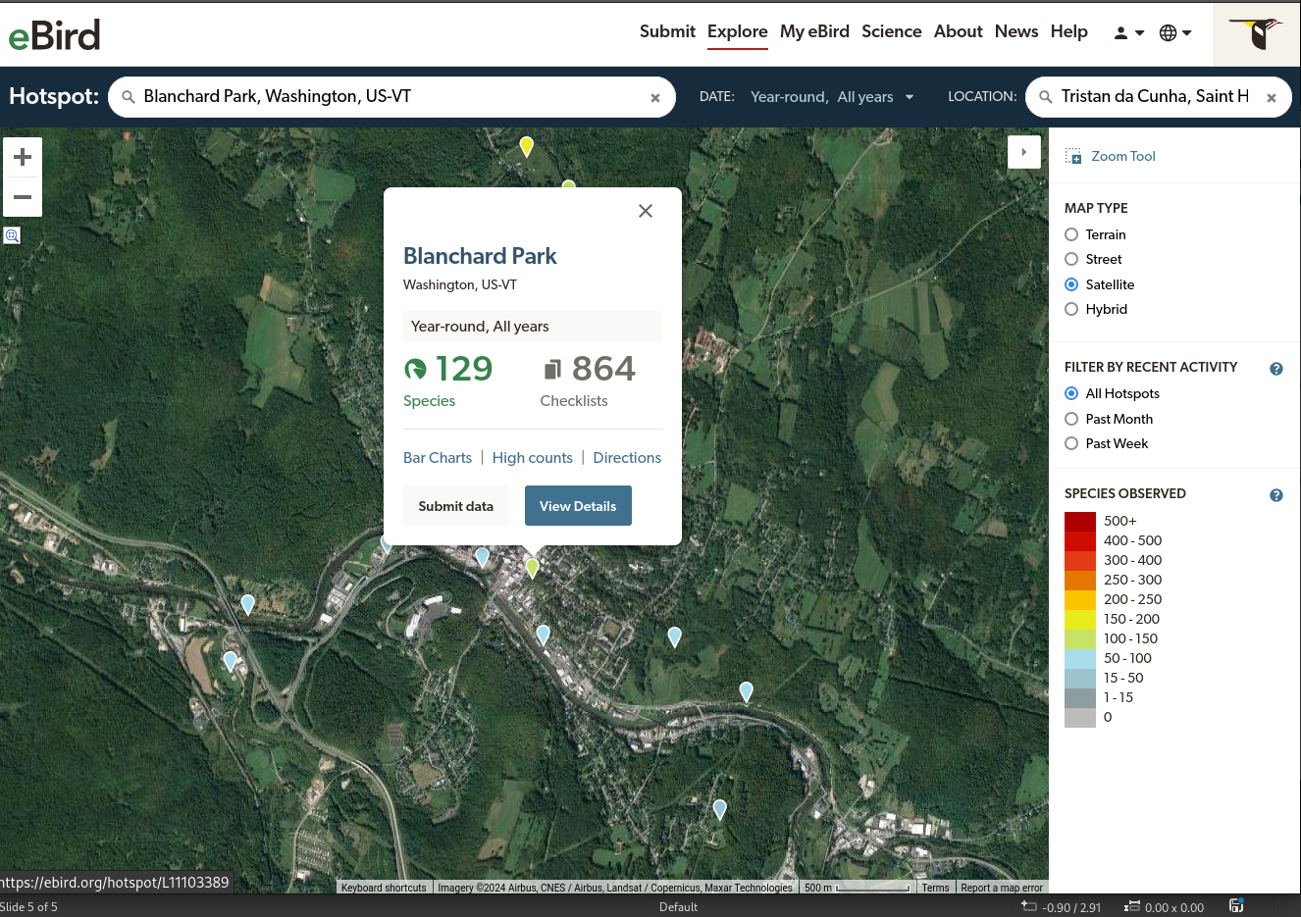

Slide 12
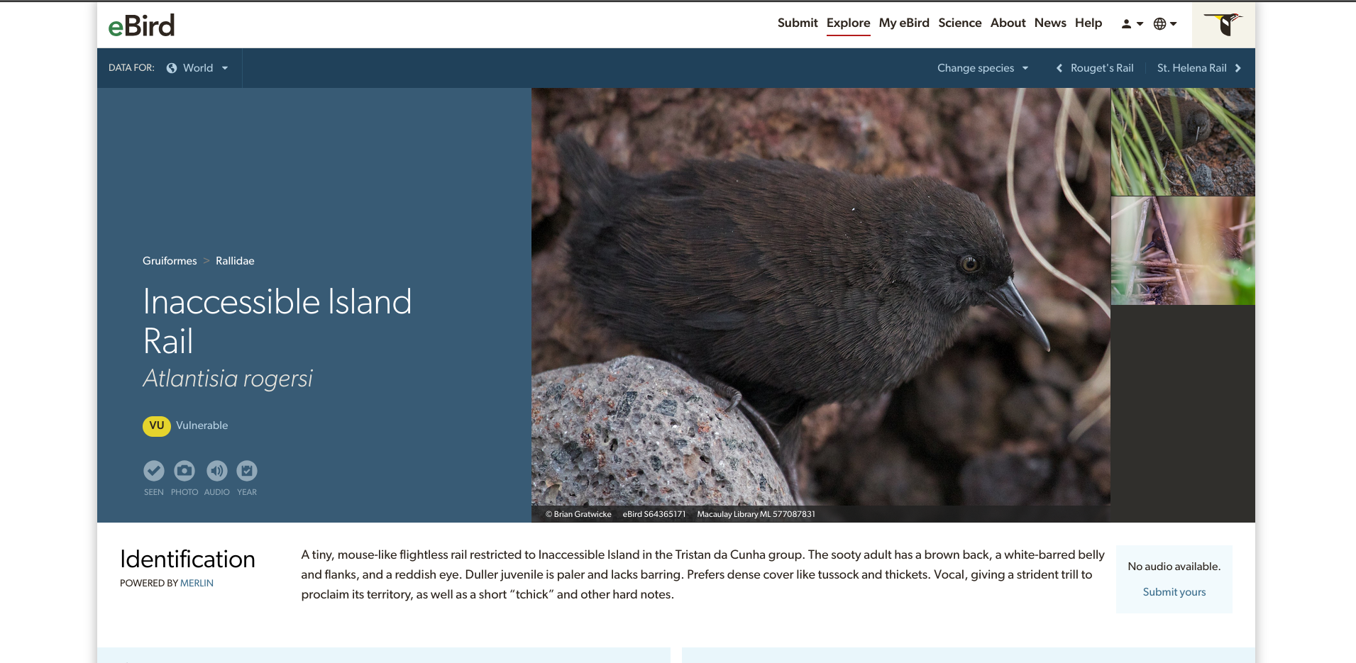

Slide 13
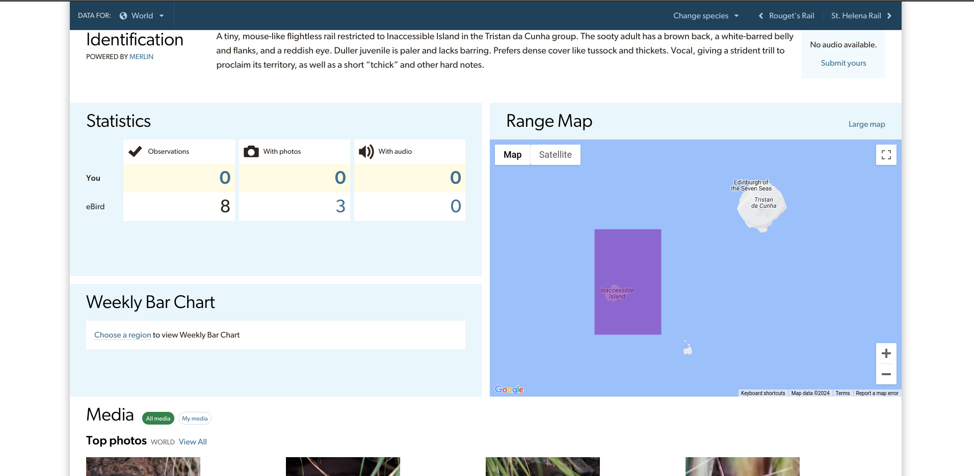

Slide 14
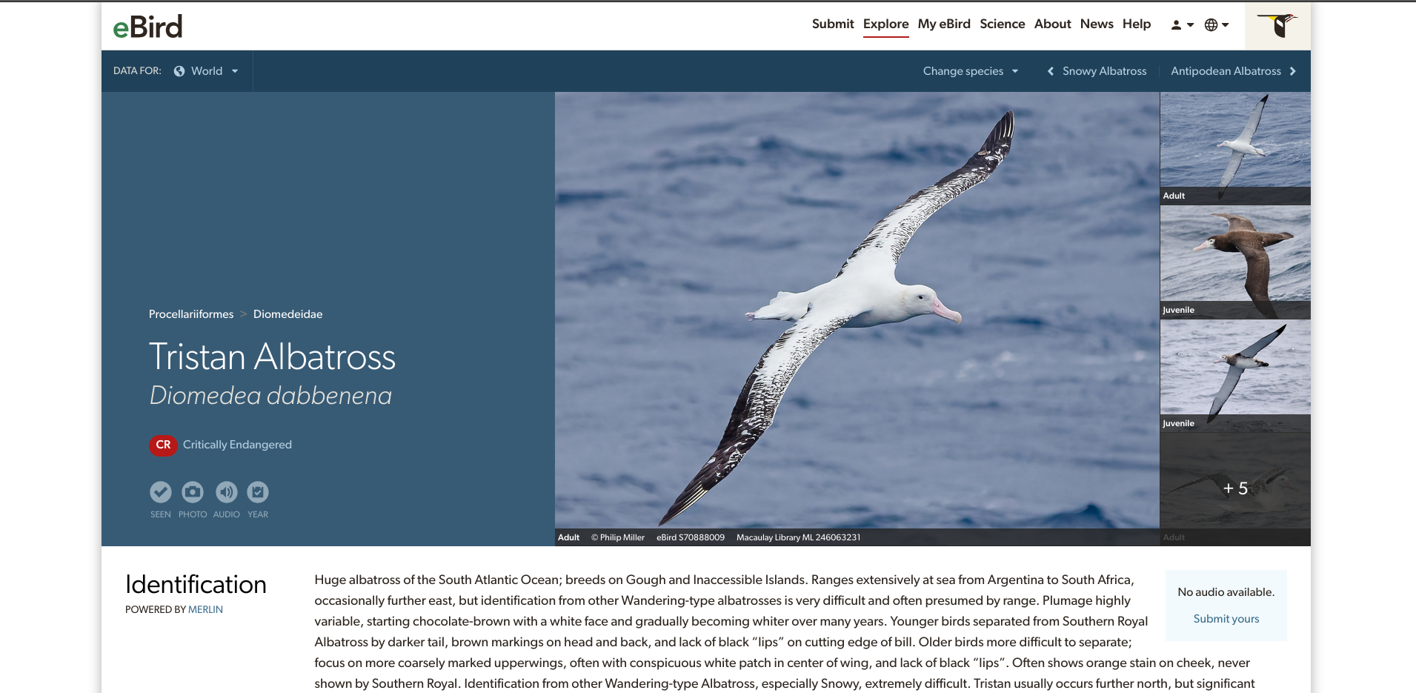

Slide 15
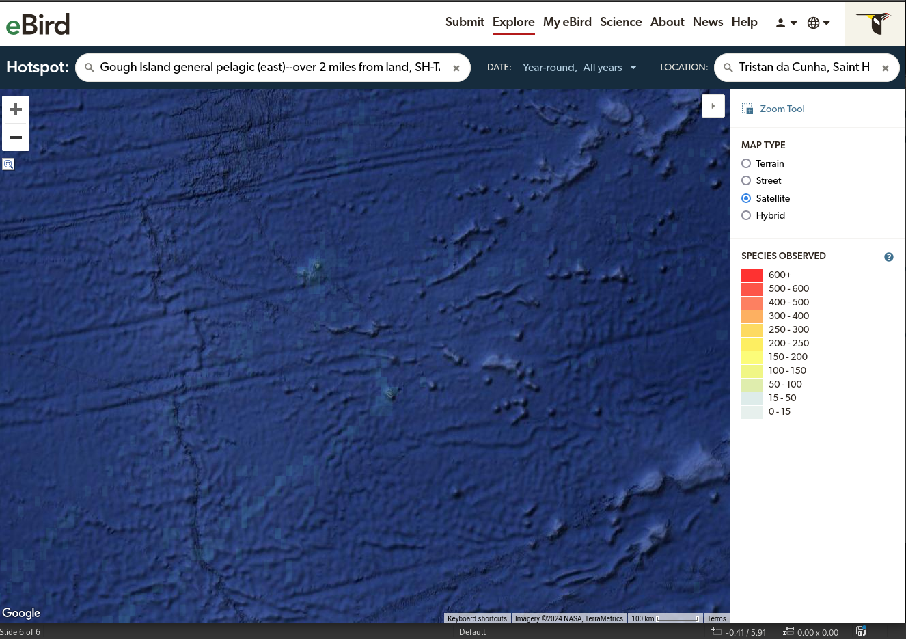

Slide 16
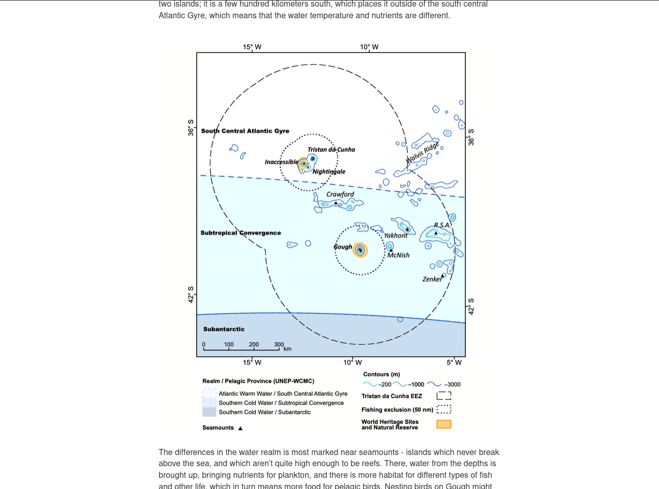

Slide 17
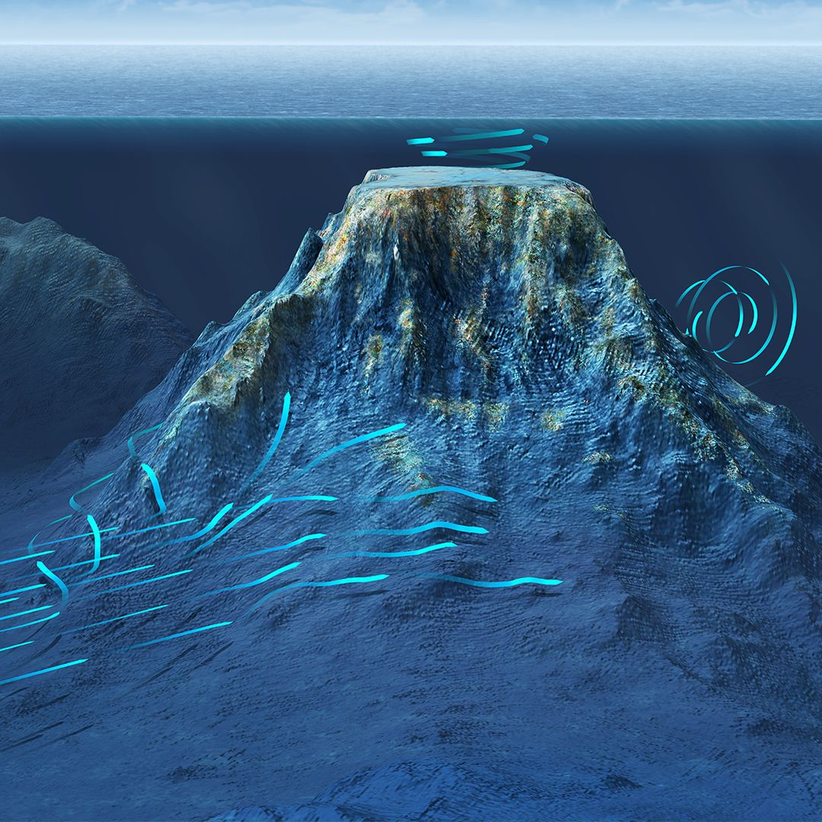
https://i.pinimg.com/originals/ff/23/a3/ff23a30fe4534714f008355ec7c385a3.jpg

Slide 18
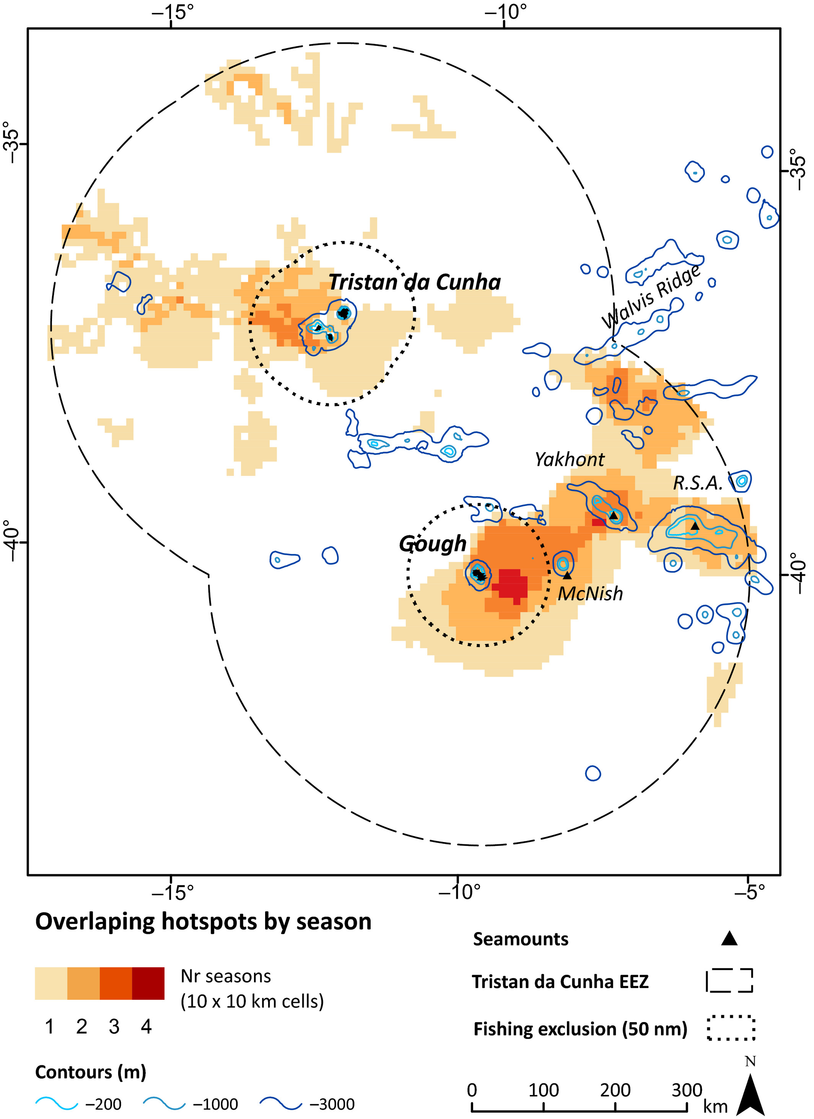
Marine hotspots of activity inform protection of a threatened community of pelagic species in a large oceanic jurisdiction
Animal Conservation, Volume: 23, Issue: 5, Pages: 585-596, First published: 25 March 2020, DOI: (10.1111/acv.12572)
Notes:
Overlap of marine multi‐species hotspots within the Exclusive Economic Zone (EEZ) of Tristan da Cunha identified from tracking data of nine seabird and one fur seal species collected between 2000 and 2018. Shading indicates in how many seasons an area was identified as a hotspot (Fig. ).
IF THIS IMAGE HAS BEEN PROVIDED BY OR IS OWNED BY A THIRD PARTY, AS INDICATED IN THE CAPTION LINE, THEN FURTHER PERMISSION MAY BE NEEDED BEFORE ANY FURTHER USE. PLEASE CONTACT WILEY'S PERMISSIONS DEPARTMENT ON PERMISSIONS@WILEY.COM OR USE THE RIGHTSLINK SERVICE BY CLICKING ON THE 'REQUEST PERMISSIONS' LINK ACCOMPANYING THIS ARTICLE. WILEY OR AUTHOR OWNED IMAGES MAY BE USED FOR NON-COMMERCIAL PURPOSES, SUBJECT TO PROPER CITATION OF THE ARTICLE, AUTHOR, AND PUBLISHER.

Slide 19
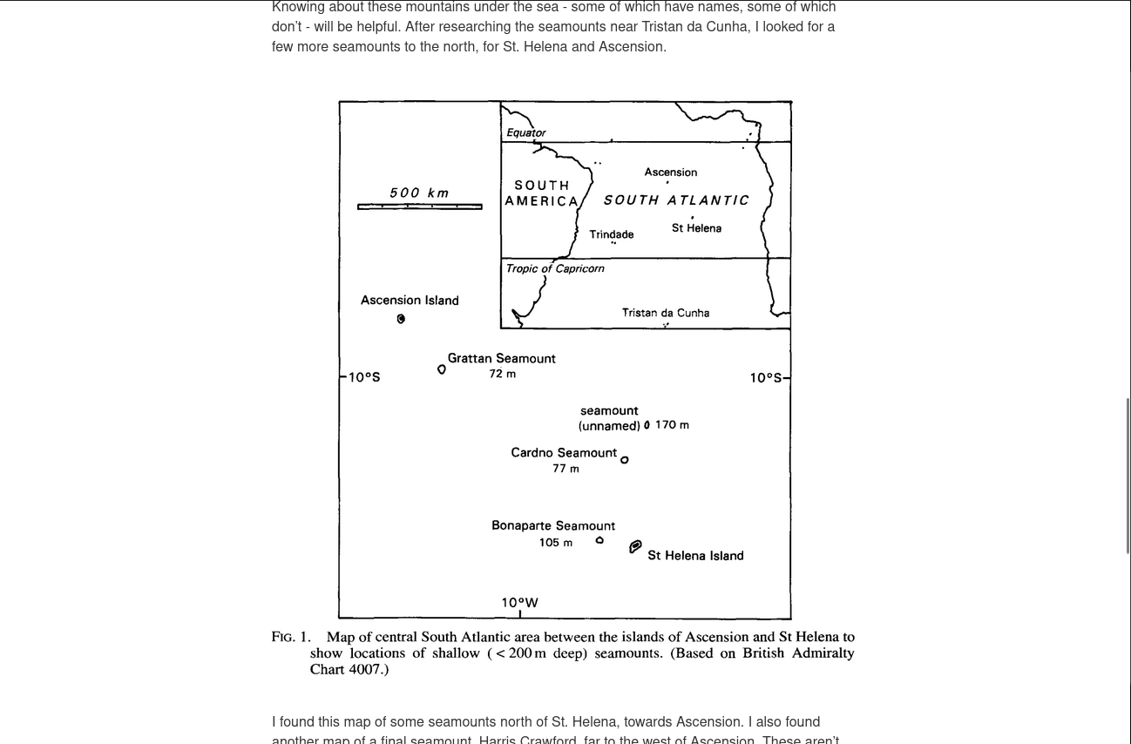

Slide 20
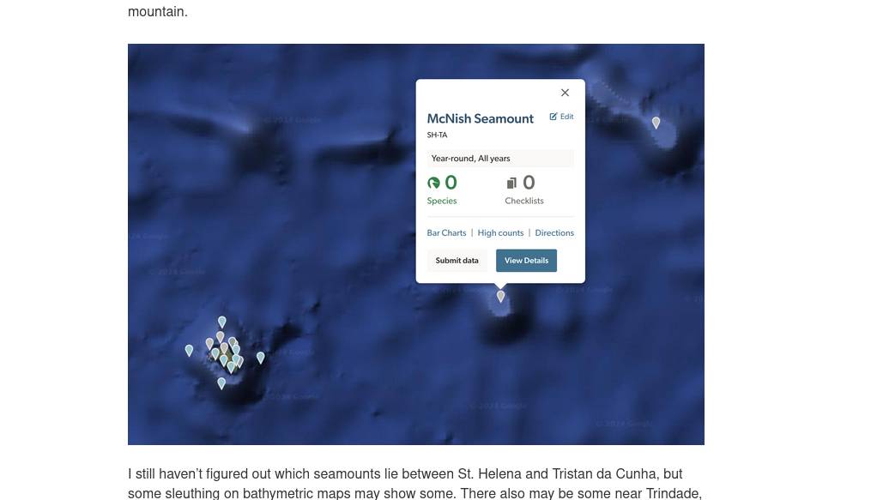

Slide 21
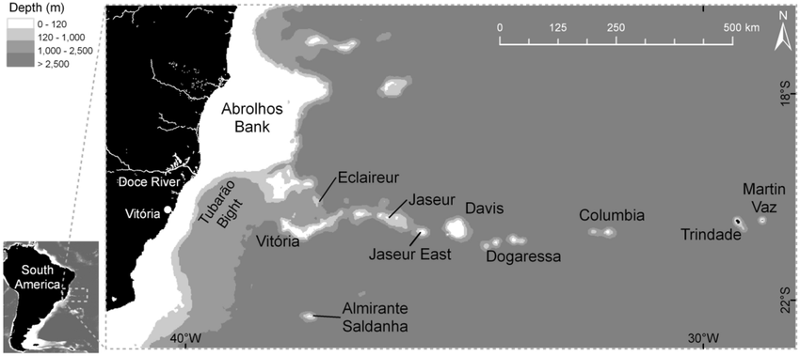

Slide 22
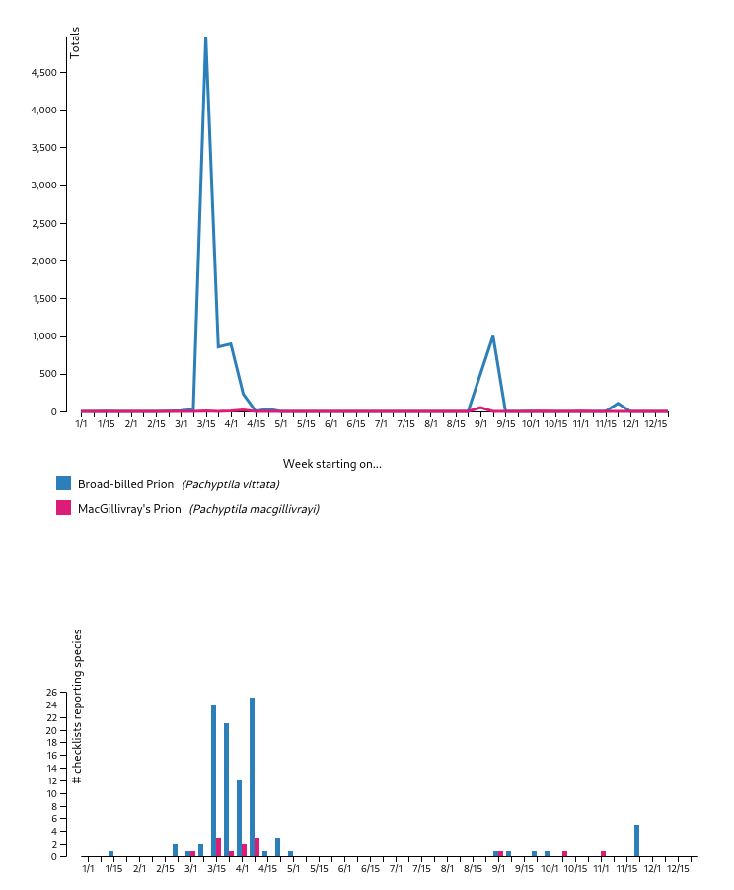

Slide 23
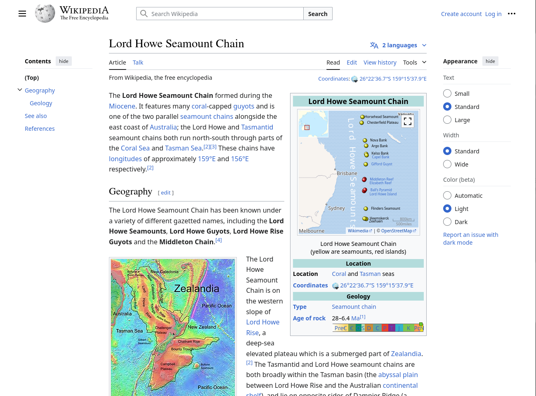

Slide 24
Thanks
Edwards, A. J. “New records of fishes from the Bonaparte Seamount and Saint Helena Island, South Atlantic.” Journal of Natural History 27.2 (1993): 493-503.
Requena, S., Oppel, S., Bond, A. L., Hall, J., Cleeland, J., Crawford, R. J., … & Ryan, P. G. (2020). Marine hotspots of activity inform protection of a threatened community of pelagic species in a large oceanic jurisdiction. Animal Conservation, 23(5), 585-596.
mastodon.social/@richlitt
https://burntfen.com
http://richard.social

